Slide 1
Web Accessibility and Inclusive Design
Computer Science Lecturer
Asma Usman

Slide 2
Objectives
Web Accessibility
Accessibility Checklist
Accessibility Evaluation Tools
Addressing Accessibility Issues
HTML and CSS Validation
Integrating Accessibility into Web Development

Slide 3
Web Accessibility?
Web disability, often referred to as web inaccessibility, refers to the barriers and challenges that people with disabilities face when using the internet.
Disable people can perceive, understand, navigate, and interact with web or contribute to the Web
Disabilities can include visual, auditory, motor, or cognitive impairments
This may result from websites that are not designed with accessibility in mind
Legal and ethical considerations of web accessibility.

Slide 4
Web accessibility significance.
Access to information and communications technologies, including the Web, is defined as a basic human right in the United Nations Convention on the Rights of Persons with Disabilities (UN CRPD).
Accessibility supports social inclusion for people with disabilities as well as others, such as:
older people
people in rural areas
people in developing countries
Disable people

Slide 5
Achieve Web Accessibility
Design with Inclusivity in Mind: Develop websites with a focus on inclusive design from the start.
Follow Web Standards: Adhere to web accessibility standards and guidelines, such as the Web Content Accessibility Guidelines (WCAG).
Testing and Evaluation: Regularly test and evaluate websites using accessibility evaluation tools to identify and address issues.
User Involvement: Include individuals with disabilities in the design and testing process to gain insights and feedback.
Continuous Improvement: Accessibility is an ongoing process; regularly update and improve your website's accessibility features.

Slide 6
Accessibility Checklist
Semantic HTML: Use proper HTML elements (e.g., headings, lists, forms) to structure content.
Alternative Text for Images: Provide descriptive alt attributes for all images.
Keyboard Navigation: Ensure interactive elements are operable via the keyboard.
Focus Styles: Include visible focus styles for keyboard navigation.
Contrast Ratio: Maintain sufficient contrast between text and background colors.
Resize Text: Allow text to be resized without loss of content or functionality.
Forms and Labels: Label form elements correctly and provide error messages and instructions.
Headings and Structure: Use headings in a logical order for clear content structure.
Links: Use descriptive link text instead of generic terms.
Video and Audio: Provide captions for video and transcripts for audio.
Tables: Use tables for tabular data only and include proper headers and summaries.
ARIA Roles and Attributes: Use ARIA to enhance accessibility when necessary.
Skip Navigation: Include a "skip to content" link for user navigation.

Slide 7
Why Accessibility Checklist
Ensures Inclusivity: A checklist helps guarantee that web content is accessible to everyone, including people with disabilities.
Legal Compliance: It helps meet legal requirements, avoiding potential penalties and lawsuits.
Better User Experience: Following accessibility guidelines enhances the user experience for all visitors.
Expands Audience: An accessible website accommodates a broader audience, potentially increasing engagement.
Boosts SEO: Search engines favor accessible sites, improving discoverability.
Demonstrates Commitment: Prioritizing accessibility shows social responsibility and inclusivity.
Encourages Innovation: Accessibility promotes the development of inclusive technology and design.

Slide 8
There are evaluation tools that help with evaluation. However, no tool alone can determine if a site meets accessibility guidelines. Knowledgeable human evaluation is required to determine if a site is accessible.

Slide 9
Activity 1: Using an Accessibility Checklist
Sample checklist
Assess a given webpage using the checklist
Discuss the results as a group
Write 10 points

Slide 10
Accessibility Evaluation Tools
Accessibility evaluation tools are software applications or online services designed to assess and identify issues related to web accessibility on websites and digital applications. These tools are used to evaluate the compliance of a website with established accessibility standards, such as the Web Content Accessibility Guidelines (WCAG). Accessibility evaluation tools help web developers, designers, and content creators ensure that their digital content is accessible to individuals with disabilities, including those with visual, auditory, motor, or cognitive impairments.

Slide 11
Accessibility Evaluation Tools
Automated Scanning: These tools use automated algorithms to scan web pages, evaluate their code, structure, and content, and identify potential accessibility issues. This process helps to quickly pinpoint common problems.
Reports and Feedback: After scanning a website, accessibility evaluation tools generate detailed reports that highlight identified issues. These reports often include recommendations for remediation.
Real-time Feedback: Some tools provide real-time feedback as users interact with a web page, making it easier to identify issues as they occur.
Integration: Many tools can be integrated into the development process, making accessibility evaluation a part of ongoing web development and content creation.
Support for Standards: These tools are designed to assess websites for compliance with established accessibility standards and guidelines, such as WCAG.

Slide 12
Accessibility Evaluation Tools
WAVE (Web Accessibility Evaluation Tool): A widely used online tool that provides a visual representation of web page accessibility issues and offers guidance for addressing them.
Axe: An open-source accessibility testing library and browser extension for auditing web pages for accessibility issues. Axe can be integrated into development workflows.
Lighthouse: An integrated tool in the Google Chrome browser that evaluates web pages for accessibility, performance, best practices, and more.
Pa11y: An open-source, command-line-based accessibility testing tool for automating the testing of web pages.
Tenon: A commercial accessibility testing tool with both online and API-based services for evaluating websites for accessibility compliance.
AInspector: A Firefox browser extension that provides accessibility evaluation and testing features.
The W3C Markup Validation Service: The W3C Markup Validation Service helps web developers and designers identify and correct errors in their HTML code, ensuring that web pages comply with HTML standards and are displayed correctly across various browsers.

Slide 13
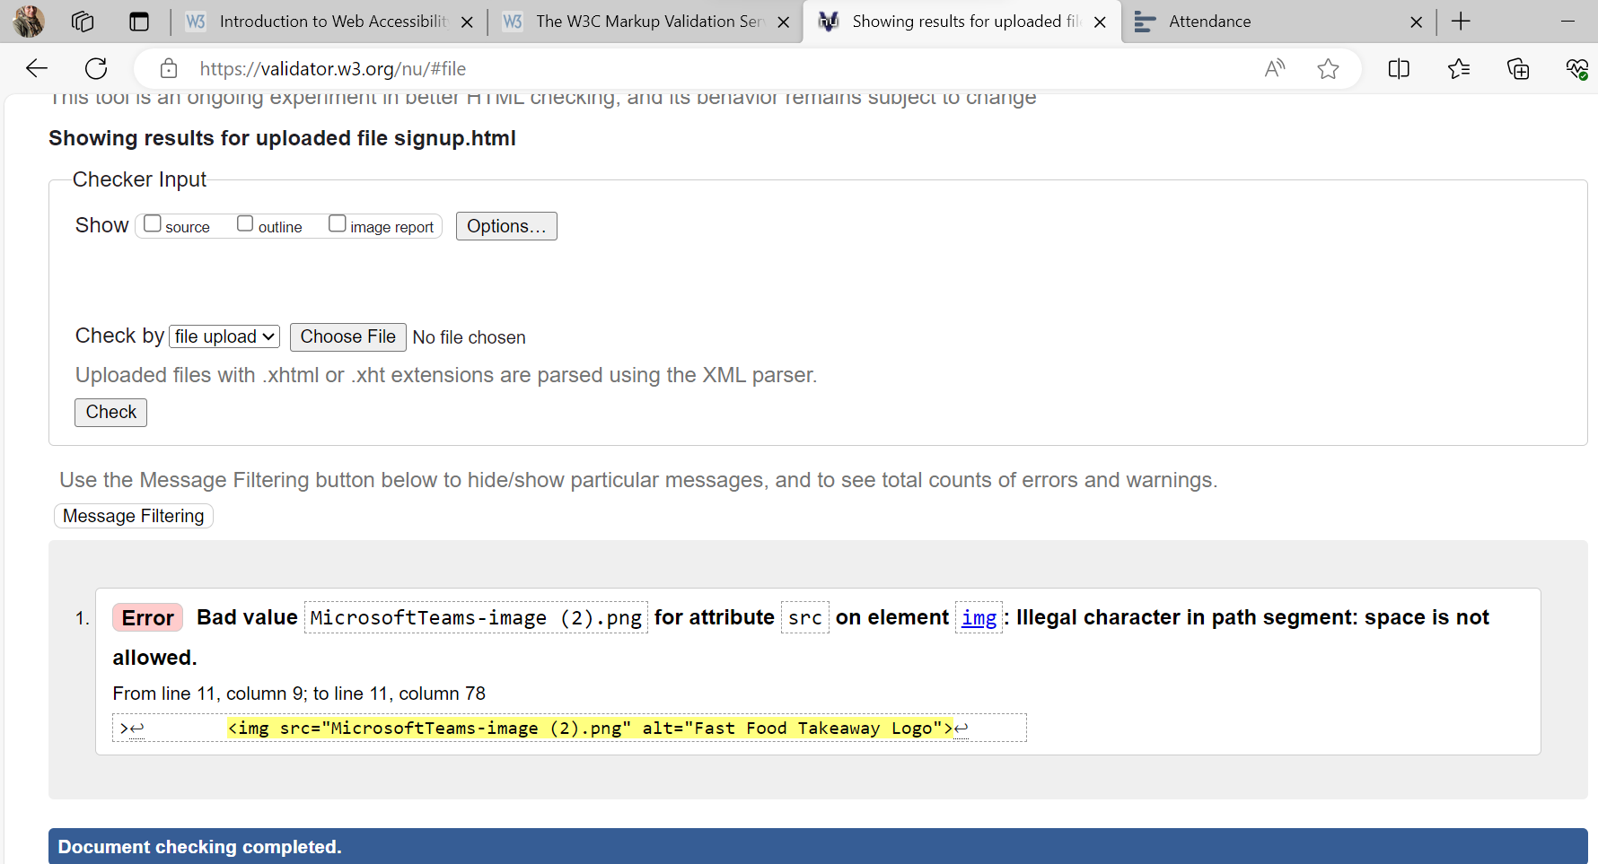
Demonstration
<img src="MicrosoftTeams-image-2.png" alt="Fast Food Takeaway Logo">

Slide 14
Activity 2: Using an Accessibility Evaluation Tool
Evaluate a sample webpage using the tool
Discuss the results, highlighting identified accessibility issues

Slide 15
HTML and CSS Validation
What is validation
Cross-Browser Compatibility
Improves Code Quality
Enhances SEO Performance
Helps with Debugging
Adherence to Web Standards
Why HTML validation
Ensures Proper Structure
Identifies Syntax Errors
Supports Accessibility
Improved SEO
Compatibility with Future Technologies

Slide 16
Why CSS validation
What and why CSS validation.
Maintains Consistency
Identifies Syntax Errors
Compatibility Across Browsers
Ensures Faster Loading Times
Improved Code Maintainability

Slide 17
Common Validation Errors
Unclosed Tags
Mismatched Quotes
Missing or Misused Selectors
Unsupported Properties
Best Practices for Validation
Validate Early and Often
Use Real-Time Validation Tools
Keep Your Code Organized
Stay Informed About Web Standards

Slide 18
User Testing
Real User Experiences: Testers with disabilities provide genuine user experiences, allowing developers to understand how real users interact with their websites.
In-Depth Feedback: Testers can offer detailed feedback about specific barriers, making it easier to identify and address accessibility issues.
Diverse Perspectives: Different disabilities may result in varied challenges, providing a more comprehensive perspective on accessibility.
Unforeseen Issues: Testers can uncover unexpected barriers and challenges that may not have been detected in initial assessments.
Usability Insights: In addition to accessibility, user testers can provide feedback on general usability, improving the overall user experience.
Prioritization: Testers can help prioritize accessibility fixes by highlighting which issues have the most significant impact on their experience.
Human Stories: Personal experiences shared by testers can create empathy and a stronger commitment to accessibility within the development team.
User Satisfaction: Improving accessibility enhances user satisfaction and engagement, leading to a more successful website.
Legal Compliance: Involving individuals with disabilities demonstrates a proactive approach to accessibility, contributing to legal compliance.
Continuous Improvement: User testing fosters a culture of continuous improvement, ensuring that websites remain accessible over time.

Slide 19
Documentation notes:
Add screen shots from the validation link with errors (before)
https://validator.w3.org/#validate_by_upload+with_options
Add screen shots from the validation link without errors (after)

Slide 20
References
Convention on the Rights of Persons with Disabilities (CRPD) | Division for Inclusive Social Development (DISD) (un.org)
Introduction to Web Accessibility | Web Accessibility Initiative (WAI) | W3C
The W3C Markup Validation Service
WAVE Chrome, Firefox, and Edge Extensions (webaim.org)
Web Accessibility Evaluation Tools List (w3.org)

